Slide 1
Java to C# Transition

Slide 2
C# vs Java
C# and Java's syntaxes are very similar
One difference is the class libraries they use
C# uses the .NET class library (other .NET languages include Visual Basic, F#, IronPython, and even C++ .NET)
Java uses AWT, Swing and other libraries in addition to the standard Java API libraries.
Most large companies in the area that hire out CS graduates do some or all of their software development in C# so it is important to learn and know it.

Slide 3
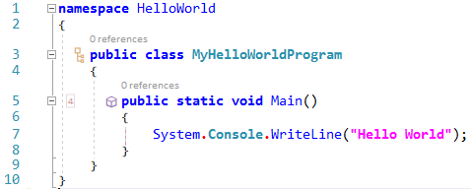
Hello World
… For example, the name of the class need not be the same as the name of the file that contains it
Somewhat fewer syntactic and structural requirements than Java …
C# is fully object-oriented like Java (C++ is not)
Main is Pascal case and may or may not have arguments
Use this syntax to write a line of text on the console window instead of Java’s System.out.println or C++’s cout

Slide 4
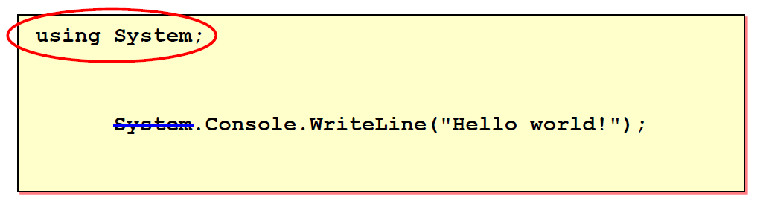
Namespaces and Using
Related classes are grouped into namespaces
Like Java packages
Namespaces may be designated for use in C# programs with a using command
Like imports in Java
If a “using” is specified for the namespace, classes from the namespace do not have to be qualified with the namespace name unless there is an ambiguity

Slide 5
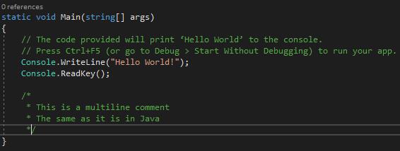
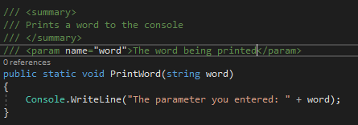
Comments
C# and Java have the same format
A single or partial line comment begins with //
A multiline block of comments begin with /* … and end with … */
XML comments are a form of block comments that start with ///
XML uses specific tags such as
<summary></summary>
<param name="parameter_name"></param>
<returns></returns>
Visual Studios can auto-generate a skeleton of XML comments for you.
This skeleton of XML comments is generated instantly

Slide 6
Code Styles
Pascal Case
Every word stars with an uppercase letter
Examples: PascalCase, TestScores, ToDoList
Camel Case
Must start with a lowercase letter and the first letter of every new word in the word must be uppercase.
Examples: camelCase, numOfStudents, boxWidth
Programmers use different programming case types for different languages. The next slide shows C#'s.

Slide 7
Identifier Naming Conventions in C#
Identifier Type | Case | Example
Class Name | Pascal | AppDomain
Enum type | Pascal | ErrorLevel
Enum values | Pascal | FatalError
Event | Pascal | ValueChange
Exception class name | Pascal | WebException Note: Name always ends with the suffix Exception.
Read-only Static field (constant) | Pascal | ReadOnlyValue
Interface | Pascal | IDisposable Note: Interface names always begin with the prefix I.
Method | Pascal | ToString
Namespace | Pascal | System.Drawing
Parameter | Camel | typeName
Property | Pascal | BackColor
Local and Private variables | Either | btnOK, lblName, txtTitle, Count, k Private fields and local variables are “for internal use only”, so their names are a matter of programmer or organizational preference.
Notes:
Shows the standard style code is typed in in C#

Slide 8
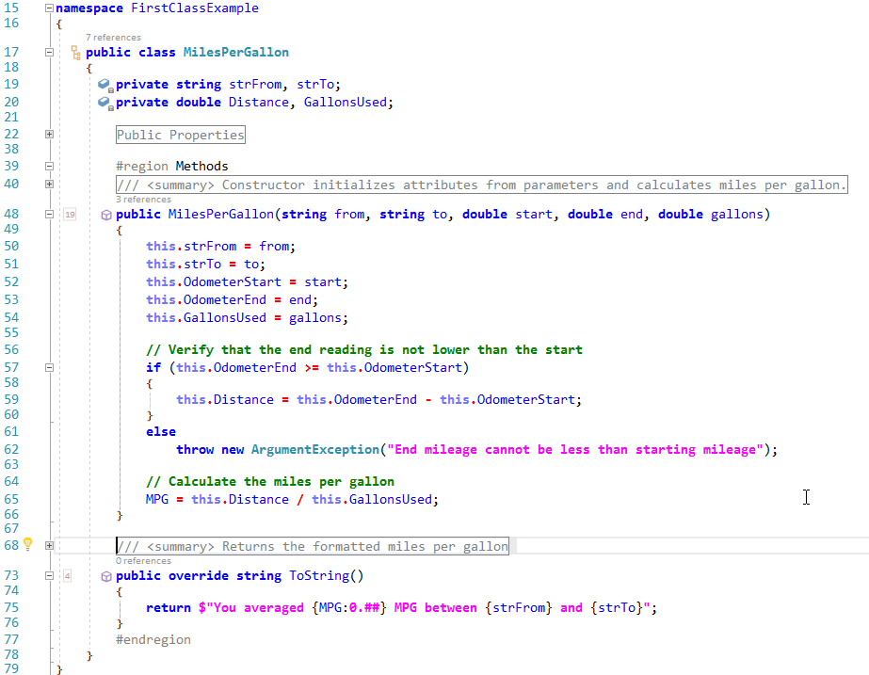
Ordinary C# Class
Attributes
Parameterized Constructor
Overridden ToString method
Interpolated string

Slide 9
Code Documentation
Please see “Policies Regarding Code Documentation” file, located in the courses management system for this course. Documentation Standards are different in C# then they are for Java or C++.
"Documentation of source code in all programming assignments is both essential and absolutely required. Visual Studio and one of its plug-ins named Ghostdoc will write the bulk of your class, file, and method header documentation for you. You only have to fill in the blanks. For class, enumeration, interface, and method headers, use XML-type (///) comments -see examples below."

Slide 10
C# Properties
Looks and acts like a variable but built like two methods

Slide 11
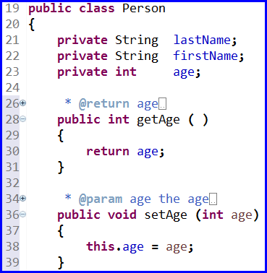
Java Properties
In Java, classes often have
Private attributes (fields) that are defined as variables of appropriate types
Public getter and/or setter methods that allow a user of the class to assign a value to an attribute or retrieve the current value of the attribute
Java

Slide 12
C# Properties
In C#, the attributes (fields) and their getter/setter methods are often combined and the combinations are called Properties
Attributes can be placed on most declaration (class, method, ext.) and it restricts that object based on the type of attribute it is.
Properties are usually public and they provide access to hidden methods, like getters and settings, for interacting with private fields in the class.
Fields are usually private values that represent information to describe characteristics of a class.

Slide 13
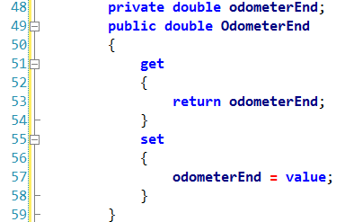

C# Property Example
Private field
Property Name
The code on the left can also be shorten down to this. C# will generate the skeleton for you with: type "prop", tab, tab
Public getter/setter combo
The term “value” is a keyword used as a parameter if none is given explicitly

Slide 14

C# Properties
Properties are used in a much simpler fashion in .NET than getters/setters are in Java
The name of the property is used as if it were a variable
The getter is automatically invoked if code is trying to retrieving the property value
The setter is automatically invoked if code is trying to assign a new property value
Setter invoked
Getter invoked

Slide 15
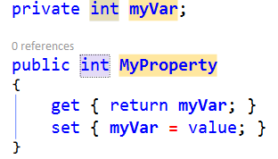
Property shortcuts
To get the “full” property with backing store and full getter/setters type propfull followed by <tab>, <tab> which generates code such as
To get a public getter with private setter use propg <tab>, <tab> to get code such as

Slide 16
C# Properties
It is good practice to replace private attributes (fields) by public properties, if you want public getters and/or setters
The underlying private attribute (field) is preserved
The public getters and setters allow controlled access to the private attribute
A property may have a public getter with a private setter to let the outside to retrieve but not change the value
The get or set may be left out all together if the property is a write-only or a read-only property

Slide 17
Working with Data
Data types and operators

Slide 18
Primitive Data Types
Java
C#
byte
short
int
long
float
double
boolean
char
Value Types
Signed integral (negative and positive whole numbers)
sbyte, short, int, long
Unsigned integral (positive whole numbers)
byte, ushort, uint, Ulong
Unicode Character
char
IEEE floating point
float, double
High-precision decimal
decimal
Boolean
bool
Enum
Enum
Struct
struct
Nullable value types
null
Reference Types
Class
object, string, class C { … }
Interface
interface I { … }
Array Types
(e.g. int [100], int [100, 100])
Delegate Types
(e.g. delegate int D( … ))

Slide 19
Summarizes of C#'s numeric types
Signed Integral
sbyte: 8 bits, range from –128 – 127
short: 16 bits, range from –32,768 – 32,767
int: 32 bits, range from –2,147,483,648 – 2,147,483,647
long: 64 bits, range from –9,223,372,036,854,775,808 to 9,223,372,036,854,775,807
Unsigned Integral
byte: 8 bits, range from 0 – 255
ushort: 16 bits, range from 0 – 65,535
uint: 32 bits, range from 0 – 18,446,744,073,709,551,615
Floating Point
float: 32 bits, range from 1.5 x 10-45 – 3.4 x 1038, 7-digit precision
double: 64 bits, range from 5.0 x 10-324 – 1.7 x 10308, 15-digit precision
Decimal
decimal: 128 bits, range is at least –7.9 x 10-28 – 7.9 x 1028, with at least 28-digit precision

Slide 20
Mathematical Operators
C# and Java have the same Operators
+, -, *, /
Basic arithmetic
%
Modulus or computes the remainder of two numbers
++, --
Increments or decrements by 1
Position of the ++ or – may matter
+=, -=, *=, %=
Computes the variable inside the left side of the equation with the value in the right side of the equation and then stores the results to the variable

Slide 21
Order of Operations
Category | Operator | Associativity
Postfix | () [] -> . ++ - - | Left to right
Unary | + - ! ~ ++ - - (type)* & sizeof | Right to left
Multiplicative | * / % | Left to right
Additive | + - | Left to right
Shift | << >> | Left to right
Relational | < <= > >= | Left to right
Equality | == != | Left to right
Bitwise AND | & | Left to right
Bitwise XOR | ^ | Left to right
Bitwise OR | | | Left to right
Logical AND | && | Left to right
Logical OR | || | Left to right
Conditional | ?: | Right to left
Assignment | = += -= *= /= %=>>= <<= &= ^= |= | Right to left
Comma | , | Left to right

Slide 22
Code
Comparisons of the different concepts

Slide 23
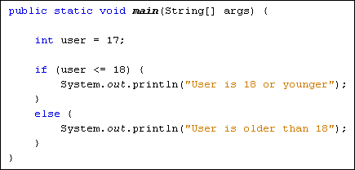
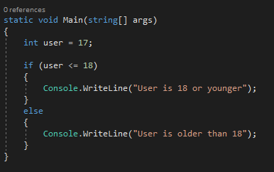
If Statement (Logic Gate)
Java
C#
Notes:
Exact same.
Java picture from https://www.homeandlearn.co.uk/java/java_if_else_statements.html

Slide 24
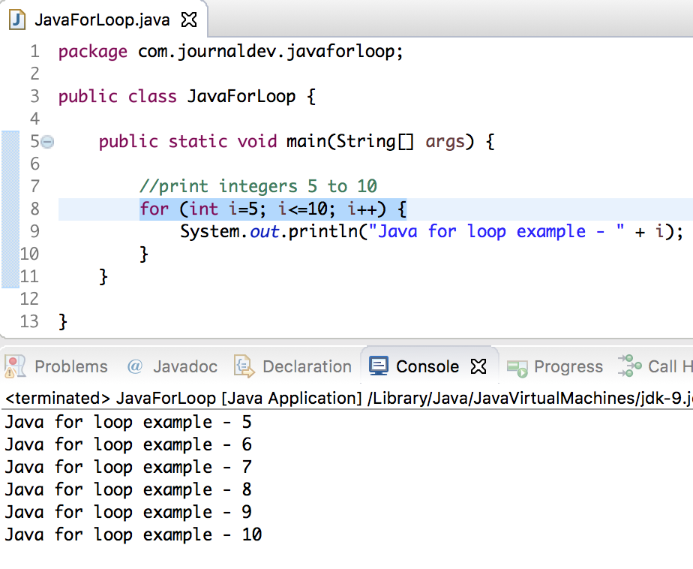
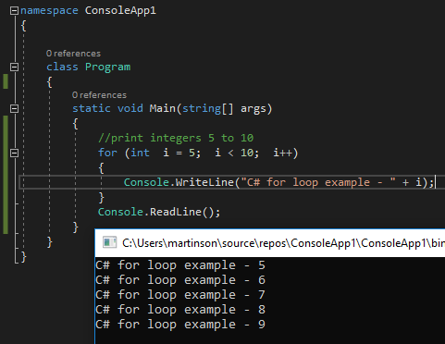
For Loops
Java
C#
Notes:
Same concept for both. C# needs that Console.ReadLine() or the text will go away immediately after it gets written to the console.
Java Image from: https://www.journaldev.com/16450/java-for-loop

Slide 25
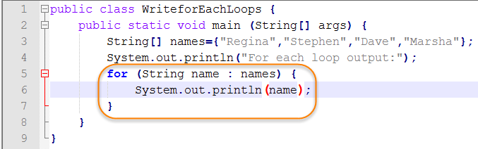
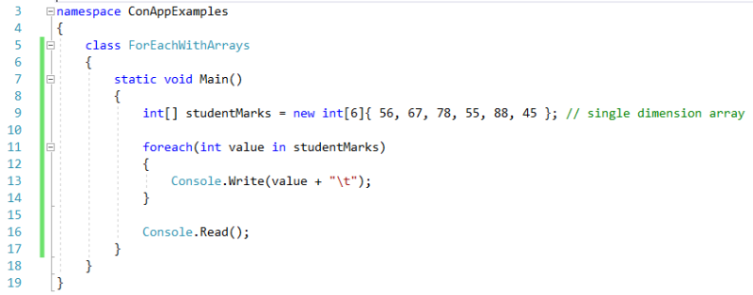
Foreach Loop
Java
C#
Notes:
Pretty similar.
Java picture from https://www.webucator.com/how-to/how-write-for-each-loops-java.cfm
C# picture from https://www.urbanpro.com/dot-net/-foreach-loop-in-c

Slide 26
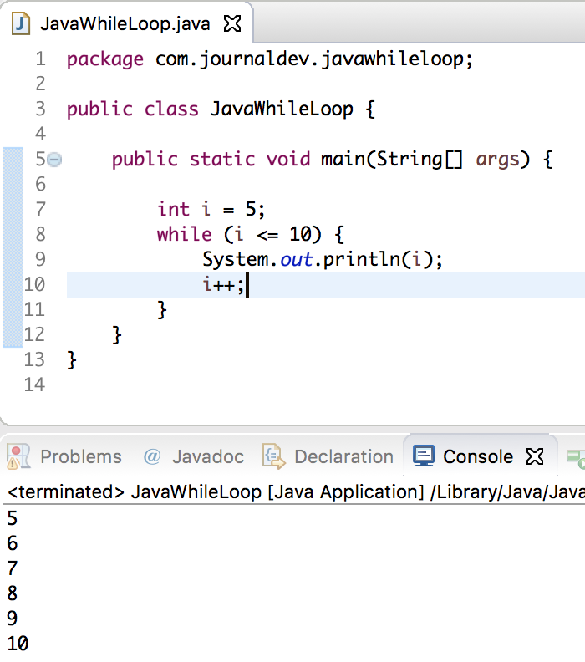
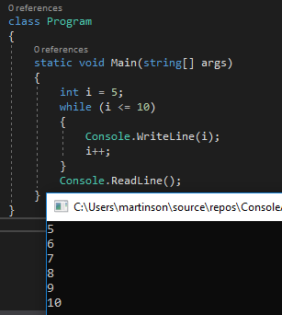
While Loop
Java
C#
Notes:
Can also add a do before the while to make it a do-while for things like menus. The do will always run.
Java picture from https://www.journaldev.com/16510/java-while-loop

Slide 27
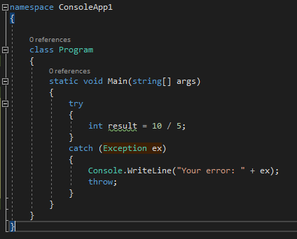
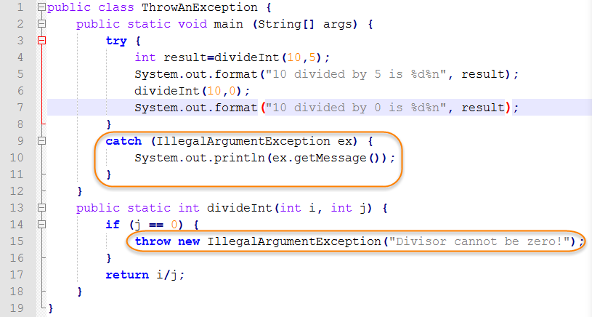
Try Catch
Java
C#
Notes:
Basically the same.
Also mention the finally block here, it also runs like a do in a do-while.
Java picture from https://www.webucator.com/how-to/how-throw-an-exception-java.cfm

Slide 28
References
Dr. Don Bailes’s CSCI 2210 Lecture Slide Series (Spring 2019)
Mr. Mathew Desjardins's 1-Object Oriented Programming Review
Various code websites for picture of code (links are in the notes of the slide the picture is in.

